Slide 1
AI Powered Travel Booking

Slide 2
System Components
The project follows a client-server architecture. Server responsible for receiving the travel-related documents, converting to embeddings and storing in the vector database. The client receives the query of the user and returns the appropriate response.
Front-End: Chat Interface
Client: Chat Interface
Server: Uploading the files
Back-End: REST API (FastAPI/Flask)
AI Agent: LangChain orchestrating LLM, vector retrieval & agents
Knowledge-Base: Travel docs, hotel info, destination guides
VectorDB: ChromaDB or FAISS
LLM Serving: Mistral 7B via Ollama
Booking APIs (Optional):
BookingAPI.dev
Skyscanner Flight & Hotel Search
Amadeus Self-Service
Booking.com Connectivity API
TripAdvisor Content API
Zilyo & MakCorps (via RapidAPI)

Slide 3
Technology Stack
LLM: Mistral 7B (quantized via Ollama)
Framework: LangChain + Ollama
Vector Database: ChromaDB or FAISS
Backend: FastAPI (Python)
Frontend: React/Angular/Vue/CLI (prototype phase)

Slide 4
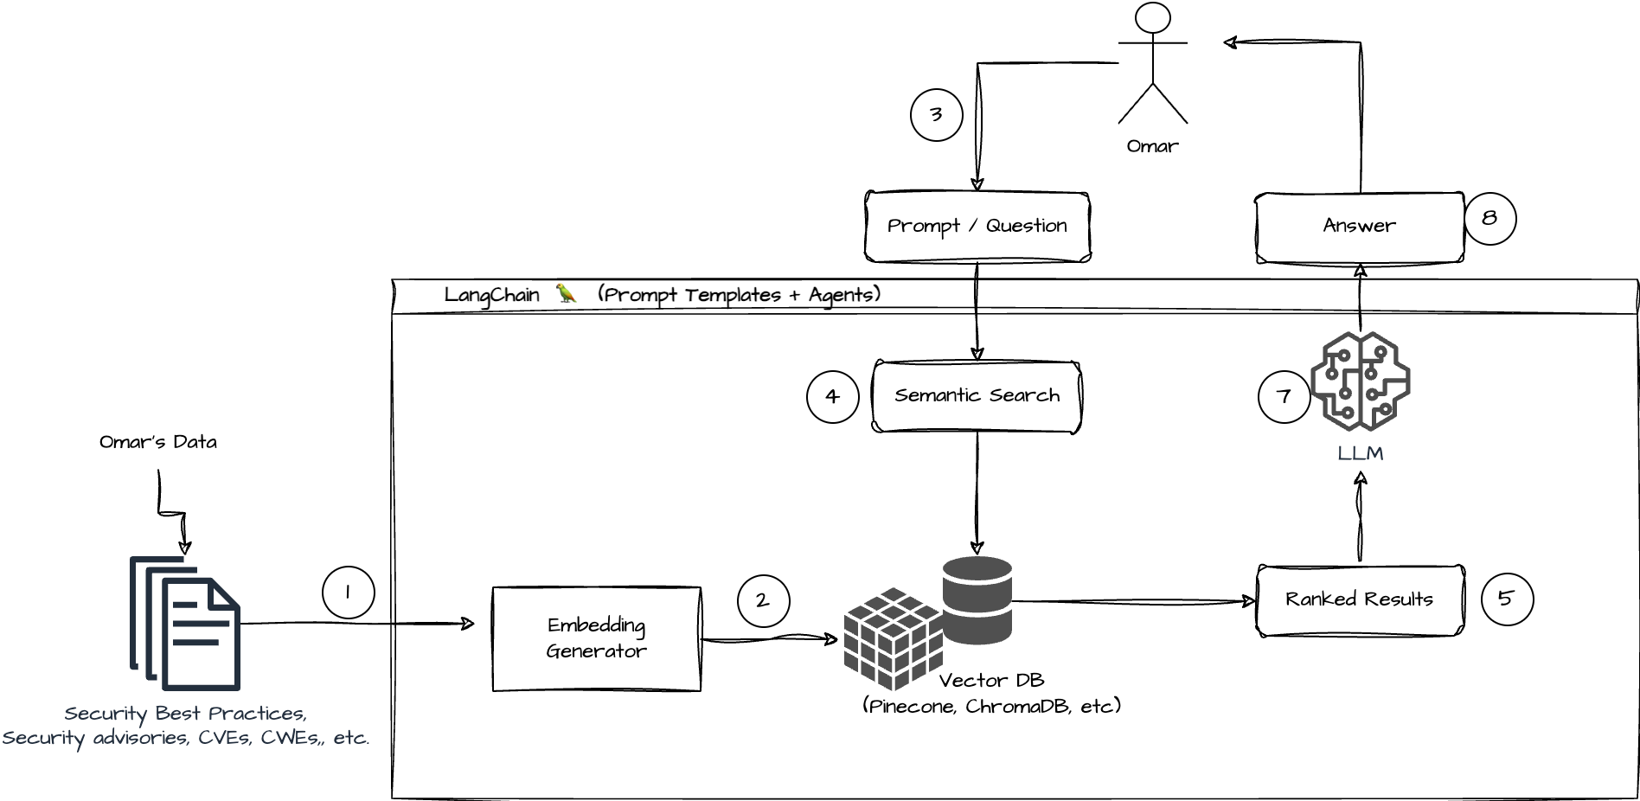
Architecture Diagram

Slide 5
Data Ingestion & RAG Pipeline
Objective: Create a structured, searchable knowledge base from Telangana travel data to power AI-generated responses.
Workflow
Data Collection: Source content from blogs, tourism websites, hotel descriptions, and user reviews.
Document Loading: Use LangChain loaders to read text files.
Text Splitting: Use TextSplitter to divide content into manageable chunks.
Embedding: Convert text chunks into vectors using OllamaEmbeddings.
Vector Store: Store embeddings in ChromaDB or FAISS for efficient retrieval.
Pipeline Flow: User Query → Retrieve Relevant Docs → Send to Mistral Model → Generate Answer
Outcome
Accurate and context-aware answers based on real-world travel data.

Slide 6
Chat Interface & Agents
Components
Interface: Initially built as a command-line interface (CLI); web UI
LangChain Chain: Uses ConversationalRetrievalChain to maintain chat history and context.
Flow of Interaction: User Input → FastAPI Backend → LangChain RAG → Vector Store + Mistral → Response
Outcome
A conversational AI system capable of understanding user preferences and generating dynamic travel plans.

Slide 7
Advanced features (Optional)
Objective :Provide the ability to book hotels or experiences directly from the assistant in future phases.
Potential Features:
API Integration: Connect to hotel booking platforms if we make good progress
Media Display: Show images or videos of places and accommodations using public APIs.
Itinerary Export: Generate downloadable PDFs with travel plans.

Slide 8
Development Plan & Milestones
Phases | Objective | Tasks | Timeline
Phase 1 | Lay the foundation for the system architecture and finalize the technology stack. | - Define system components and data flow - Select and install required tools (FastAPI, LangChain, Ollama, ChromaDB) - Design architecture diagram | Week 1
Phase 2 | Build the AI core with retrieval-augmented generation for personalized travel recommendations. | - Curate Telangana tourism dataset - Preprocess and chunk documents - Embed using Ollama-compatible models - Store in vector DB (ChromaDB/FAISS) - Implement LangChain RAG pipeline | Week 2
Phase 3 | Develop backend services and integrate the AI agent with frontend and APIs. | - Set up FastAPI endpoints - Connect backend with RAG pipeline - Implement REST APIs for chat and optional booking - Error handling and logging | Week 3

Slide 9
Development Plan & Milestones
Phases | Objective | Tasks | Timeline
Phase 4 | Create a responsive user interface for interacting with the AI assistant. | - Design a simple and intuitive chat UI (React/Terminal) - Connect frontend to backend APIs - Display responses, optional images/videos - Handle loading states and fallback messages | Week 4
Phase 5 | Finalize and polish the application for demo and evaluation. | - Unit testing and end-to-end testing - Prepare user and technical documentation - Create demo video or walkthrough - (Optional) Package for deployment | Week 5

Slide 10
References & Resources
Learning Resources
https://www.coursera.org/learn/fundamentals-of-ai-agents-using-rag-and-langchain#modules
https://www.youtube.com/watch?v=1y2TohQdNbo
LangChain Documentation https://python.langchain.com/docs
FastAPI Official Documentation https://fastapi.tiangolo.com
Ollama GitHub Repository https://github.com/ollama/ollama
RAG best practices blogs
https://python.langchain.com/docs/tutorials/rag/

Slide 11
Tourism Data Sources (for RAG Knowledge Base)
Telangana Tourism Official Website:
https://www.telanganatourism.gov.in
https://tgtdc.in/home
TripAdvisor : https://www.tripadvisor.in/Tourism-g7058854-Telangana-Vacations.html
Kaggle (Stats Till now):
https://www.kaggle.com/datasets/sanjay277/telangana-government-tourism-department
https://www.kaggle.com/datasets/saurabhhemne/telangana-tourism-dataset?select=Tourism+Foreign+Visitors+Data+2019_0+%281%29.csv
Git code for telangana tourism analysis : https://github.com/deepak8239gupta/Telangana-State-Tourism-Project/tree/main
Telangana Tourism Policy : https://tourism.telangana.gov.in/storage/app/media/Telangana_Tourism_Policy_2025-2030.pdf
Jyotirlinga in Telangana : https://testbook.com/telangana-gk/jyotirling-in-telangana

Slide 12
Conclusion & Team Contributions
Member | Role | Contributions
Member 1 | Backend Lead + Partial AI/ML | Working backend in FastAPI. Integration with AI model and frontend. Postman documentation (optional).
Member 2 | AI/ML + RAG + Data Curation | Dataset files + vector DB setup. Working LangChain RAG pipeline. API for RAG responses.
Member 3 | Frontend + UX + Final Integration | Responsive web UI or terminal chat. Integrated and functional user flow. Demo-ready front-end

